Slide 1
The Basic Practice of Statistics Ninth Edition David S. Moore William I. Notz
Chapter 8
Producing Data:
Sampling
Lecture Slides
© 2021 W. H. Freeman and Company

Slide 2
In Chapter 8, we cover …
Population versus sample
How to sample badly
Simple random samples
Inference about the population
Other sampling designs
Cautions about sample surveys
The impact of technology

Slide 3
Watch for these points:
A sound statistical design is necessary if we are to trust data from a sample for drawing sound conclusions about the population.
When sampling from large human populations, even with a sound design, there are still many “practical difficulties” that arise.
The impact of technology (particularly cell phones and the Internet) is making it harder to produce trustworthy national data by sampling.

Slide 4
Population versus sample
The distinction between population and sample is basic to statistics. To make sense of any sample result, you must know what population the sample represents.
The population in a statistical study is the entire group of individuals about which we want information.
A sample is the part of the population from which we actually collect information. We use information from a sample to draw conclusions about the entire population.
A sampling design describes exactly how to choose a sample from the population.
The first step in planning a sample survey is to say exactly what population we want to describe.
The second step is to say exactly what we want to measure—that is, to give exact definitions of our variables.

Slide 5
Sample Surveys
A sample of a large population is questioned on a set of topics.
No intervention or manipulation of the respondents, simply asked to answer some questions.
The first step in planning a sample survey is to say exactly what population we want to describe.
The second step is to say exactly what we want to measure, that is, to give exact definitions of our variables.
In Ch. 9 we will learn about two other research strategies: observational studies and randomized experiments

Slide 6
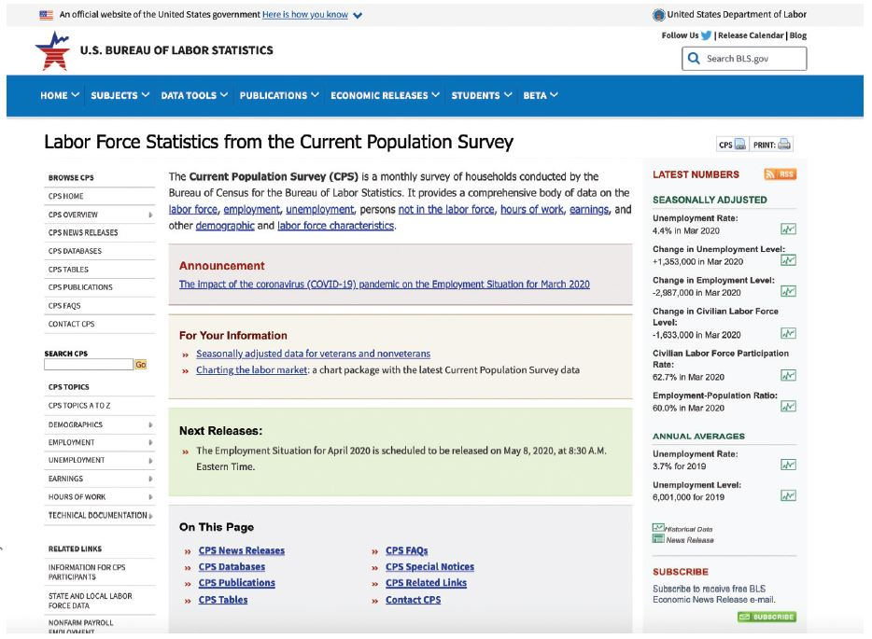
Sample survey example (1 of 2)
The most important government sample survey in the United States is the monthly Current Population Survey (CPS) conducted by the Bureau of the Census for the Bureau of Labor Statistics. The CPS contacts about 60,000 households each month. https://www.bls.gov/cps/

Slide 7
Sample survey example (2 of 2)
Determining monthly unemployment in the U.S.
Background: Bureau of Labor Statistics visits approx. 60,000 households, chosen from a list of all known households in the country (CPS).
Each adult classified: employed, unemployed, “not in labor force.” Unemployment rate: number of unemployed persons divided by the sum of the employed and unemployed.
Individuals (or units): adults in the labor force
Population of individuals: all adults in the labor force. Population of measurements: employment status (working or not working) of everyone in the labor force.
Sampling frame (or list): list of all known households in country.
Sample of units: people who were asked about their employment status.
Sample of measurements: employment status of sample.

Slide 8
Census versus Sample survey
A census is a survey in which the entire population is measured.
Advantages of Sample Surveys
When measurements destroy the units being tested, a census is not feasible.(e.g., quality control of products in the industry)
Faster to collect a sample than a census if the population is large.
Can devote resources to getting the most accurate information possible from the sample.

Slide 9
Simple random samples
Random sampling, the use of chance to select a sample, is the central principle of statistical sampling.
A simple random sample (SRS) of size n consists of n individuals from the population, chosen in such a way that every set of n individuals has an equal chance of being the sample actually selected.
In practice, people use random numbers generated by a computer or a calculator to choose samples. If you don’t have technology handy, you can use a table of random digits.

Slide 10
How to choose an SRS
A table of random digits is a long string of the digits 0, 1, 2, 3, 4, 5, 6, 7, 8, 9 with these properties:
Each entry in the table is equally likely to be any of these 10 digits.
The entries are independent of each other. That is, knowledge of one part of the table gives no information about any other part.
Using Table B to choose an SRS
Step 1: Label. Give each member of the population a numerical label of the same length.
Step 2: Table. Read consecutive groups of digits of the appropriate length from Table B.
Your sample contains the individuals whose labels you find.

Slide 11

SRS example (1 of 2)
Use the random digits provided to select an SRS of four hotels.
01 Aloha Kai 08 Captiva 15 Palm Tree 22 Sea Shell
02 Anchor Down 09 Casa del Mar 16 Radisson 23 Silver Beach
03 Banana Bay 10 Coconuts 17 Ramada 24 Sunset Beach
04 Banyan Tree 11 Diplomat 18 Sandpiper 25 Tradewinds
05 Beach Castle 12 Holiday Inn 19 Sea Castle 26 Tropical Breeze
06 Best Western 13 Lime Tree 20 Sea Club 27 Tropical Shores
07 Cabana 14 Outrigger 21 Sea Grape 28 Veranda
69051 64817 87174 09517 84534 06489 87201 97245
69 05 16 48 17 87 17 40 95 17 84 53 40 64 89 87 20
Our SRS of four hotels is 05 Beach Castle, 16 Radisson, 17 Ramada, and 20 Sea Club.

Slide 12
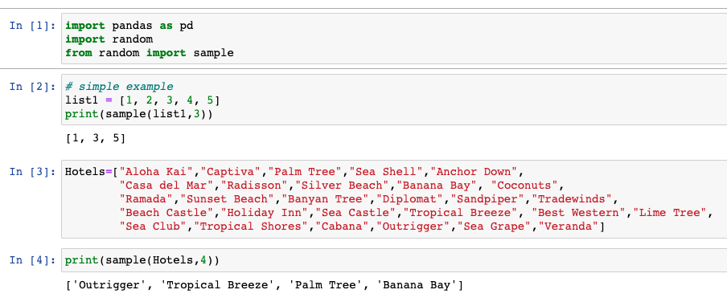
Example in Python

Slide 13
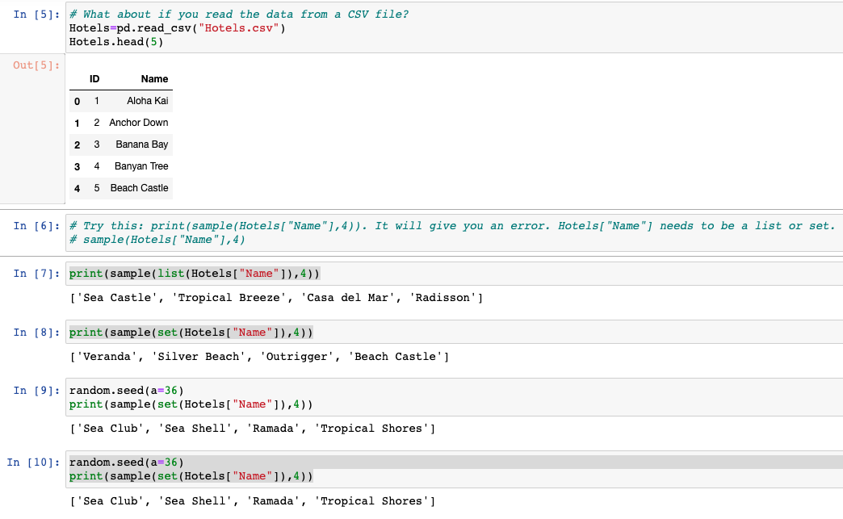
Example in Python

Slide 14
Inference about the population
The purpose of a sample is to give us information about a larger population.
The process of drawing conclusions about a population on the basis of sample data is called inference.
Why should we rely on random sampling?
To eliminate bias in selecting samples from the list of available individuals.
The laws of probability allow trustworthy inference about the population.
Results from random samples come with a margin of error that sets bounds on the size of the likely error.
Larger random samples give better information about the population than smaller samples.

Slide 15
Other sampling designs
The basic idea of sampling is straightforward: Take an SRS from the population and use your sample results to gain information about the population. Sometimes there are statistical advantages to using more complex sampling methods.
For example, one common alternative to an SRS involves sampling important groups (called strata) within the population separately. These “sub-samples” are combined to form one stratified random sample.
To select a stratified random sample, first classify the population into groups of similar individuals, called strata. Then choose a separate SRS in each stratum and combine these SRSs to form the full sample.
Another example is multistage samples.

Slide 16
Other sampling designs
Stratified Random Sampling
Cluster Sampling
Systematic Sampling
Multistage Sampling

Slide 17
Stratified Random Sampling
Divide population into groups (strata- e.g. states/provinces in a country, different majors) and take a simple random sample from each.
Advantages:
Have individual estimates for each stratum.
If variable measured gives more consistent values within each strata than within population, can get more accurate estimates of population values.
If strata are geographically separated, may be cheaper to sample them separately.
May use different interviewers within each strata.

Slide 18
Cluster Sampling
Divide population into groups (clusters), take a random sample of clusters and measure only the units of selected clusters.
Advantage: need only a list of clusters, not a list of all individual units.
Example: Sample students living in a dorm at a college
College has 30 dorms, each dorm has 6 floors 180 floors form the clusters.
Take a random sample of floors and measure everyone on those floors.

Slide 19
Systematic Sampling
Divide population list into as many consecutive segments as you need, randomly choose a starting point in the first segment, then sample at that same point in each segment.
Example:
List of 5000 names, want a sample of 100 (idea: select 1 of every 5000/100 = 50 names).
Divide the list into 100 consecutive segments of 50.
Randomly choose a starting point in the first 50 names.
Then sample every 50th name after that.

Slide 20
Multistage Sampling
Sampling plan that uses a combination of sampling methods in various stages.
Example:
Stratify by region of the country; then
Stratify by urban, suburban, and rural; then
Choose a random sample of communities within those strata.
Divide those communities into city blocks or fixed areas, as clusters, and sample some of those.
Everyone on the block or within fixed area may then be sampled.

Slide 21
Sampling designs - summary
Simple Random Sample: every conceivable group of people of the required size has the same chance of being the selected sample.
Stratified Random Sampling: divide population into groups (strata- e.g., states/provinces in a country, different majors) and take a simple random sample from each.
Cluster Sampling: Divide population into groups (clusters), take a random sample of clusters and measure only the units of selected clusters.
Systematic Sampling: Divide population list into as many consecutive segments as you need, randomly choose a starting point in the first segment, then sample at that same point in each segment.
Multistage Sampling: combination of sampling methods in various stages.

Slide 22
Cautions about sample surveys
Good sampling technique includes the art of reducing all sources of error.
Under-coverage occurs when some groups in the population are left out of the process of choosing the sample.
Nonresponse occurs when an individual chosen for the sample can’t be contacted or refuses to participate.
A systematic pattern of incorrect responses in a sample survey leads to response bias.
Wording effects are the most important influence on the answers given to a sample survey.

Slide 23
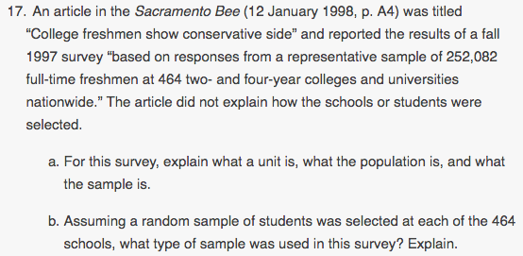
Exercise examples
Copyright ©2005 Brooks/Cole, a division of Thomson Learning, Inc.

Slide 24
Exercise examples
unit = freshman at a two- or four-year college or university in the United States
in Fall 1997, population = all such students. Sample = 252,082 students who were surveyed.
b. A stratified random sample, in which schools were the strata.

Slide 25
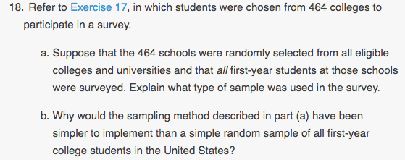
Copyright ©2005 Brooks/Cole, a division of Thomson Learning, Inc.

Slide 26
a. A cluster sample, where each school is a cluster.
b. It would be easier to obtain a list of all schools than a list of all students from all schools. After selecting a random sample of schools, you need to obtain a list of all first-year students only at those schools.

Slide 27


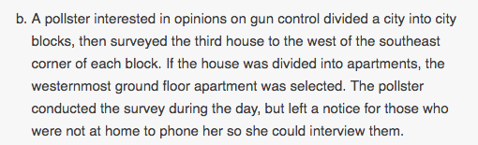
Copyright ©2005 Brooks/Cole, a division of Thomson Learning, Inc.

Slide 28
→ Cluster sampling; unbiased

Slide 29
→ Cluster sampling; unbiased
→ Systematic sampling. Biased: ground floor residents may share same opinion.
Those at home during day may differ from those not at home, and only those with strong opinions would call back.

Slide 30
Cautions about sample surveys
Good sampling technique includes the art of reducing all sources of error.
Under-coverage occurs when some groups in the population are left out of the process of choosing the sample.
Nonresponse occurs when an individual chosen for the sample can’t be contacted or refuses to participate.
A systematic pattern of incorrect responses in a sample survey leads to response bias.
Wording effects are the most important influence on the answers given to a sample survey.

Slide 31
Having a Low Response Rate
Even the best surveys are not able to contact everyone on their list, and not everyone contacted will respond.
Response rates should be reported in research summaries.
The lower response rate → the less results can be generalized to the population.
Survey response is voluntary, those who respond likely to have stronger opinions than those who do not.
Use or reminders, follow up calls can decrease nonresponse rate.

Slide 32
How to sample badly
A sample selected by taking the members of the population that are easiest to reach is called a convenience sample.
The design of a sample is biased if it systematically favors certain outcomes.
Caution: People who take the trouble to respond to an open invitation are usually not representative of any clearly defined population.
A voluntary response (or volunteer) sample consists of people who choose themselves by responding to a general appeal. Voluntary response samples show bias, because people with strong opinions are most likely to respond.

Slide 33
Getting a Volunteer or Self-Selected Sample
Relying on volunteer responses presents difficulties but relying on a volunteer sample is a waste of time.
Example: A Meaningless Poll
Television poll vs. properly conducted study
→ Such ‘volunteer polls’ are just a count of who bothered to go to the telephone and call.

Slide 34
Using a Convenience Sample
Using the most convenient group available or deciding on the spot who to sample can produce misleading results.
Example:
Students in Introductory Statistics classes may be representative of all students at a university on extent of drug use in high school, but not on how many hours students study each week.

Slide 35
Impact of technology
The expense of using personal interviews to do surveys has led to most studies being conducted with technology-based data collection.
Issues
Random-digit dialing has grown less useful, because call screening is now nearly universally practiced and the proportion of homes with no landline has increased.
Web surveys are used more frequently but are difficult to do well.

Slide 36
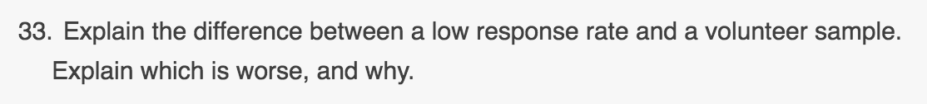

Slide 37
A low response rate refers to a survey given to a legitimate random sample, but where many don’t respond.
A volunteer sample consists of those who respond to a publicly announced survey.
A volunteer sample is worse because there is no way to know whether it represents any larger group.

